Slide 1
iPhone Programming Introduction
TMA Training Center (TTC)
Course | iPhone application development
Trainer | Son Nguyen
Designed by | TMA Mobile Solutions (TMS)
Last updated | 12 May 2011

Slide 2
This section objectives
Understanding about :
  Mobile Programming
  Building an iPhone application
  MAC OS
  iPhone OS
  Xcode
  Objective C
  Memory Management

Slide 3
Content
  Mobile Programming
  iPhone App Development Guide
  MAC OS
  iPhone OS
  Xcode
  Objective C
  Memory Management

Slide 4

Mobile Programming
Create application software for small low-power handheld devices
These applications are either pre-installed on phones during manufacture, or downloaded by customers from various mobile software distribution platforms

Slide 5
Mobile Development Paradigm
Important to know the specs of the hardware you are designing
To maximize efficiency, purpose, performance…
Limited memory and Internet bandwidth
Limited Battery Life
Limited Screen real estate
Ease of Use
‘On the go’ vs sitting down on a desktop

Slide 6
Why iPhone?
The device that revolutionized the mobile market
The App Store!
Leading other companies to follow Apple’s model
  RIM – Blackberry App World
  http://appworld.blackberry.com/webstore/
  Microsoft –Windows Phone Marketplace
  http://marketplace.windowsphone.com/Default.aspx
  Nokia –Ovi Store
  http://store.ovi.com/
  Samsung – Samsung Apps
  http://www.samsungapps.com/
  and more…

Slide 7
Guide to App Development
Go to http://developer.apple.com/iphone/index.action
  Getting started articles and videos
  Downloads
  Primers to frameworks and Objective C
Download iPhone SDK (you will need Mac OSX 10.6.5 or higher)
  Download iPhone SDK 4.0
Learn and apply knowledge from this course and recommended reading
  Have fun and experiment!
Try running a few example applications by downloading Sample Code and trying them on the iPhone simulator
Become an Apple Developer for $99 to test on iPhone and deliver to App Store
  http://developer.apple.com/programs/iphone

Slide 8
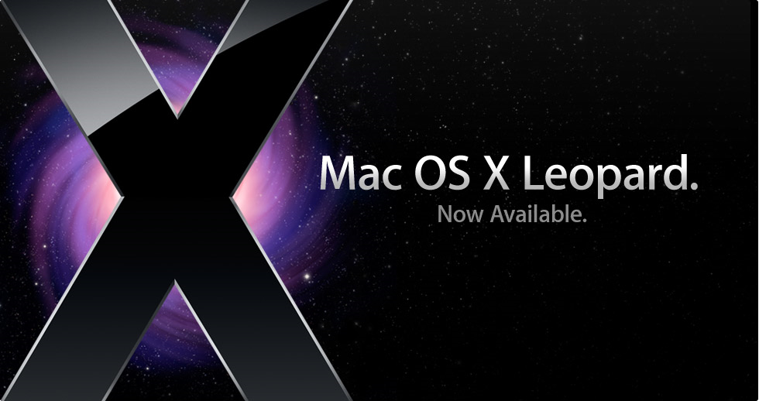
MAC OS Demo

Slide 9
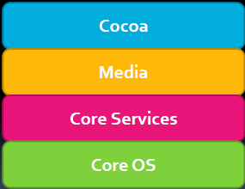
The Mac OS
•The Mac OS X consists of four frameworks

Slide 10
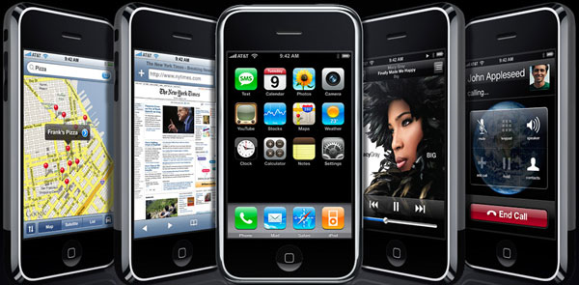
iPhone OS Demo

Slide 11
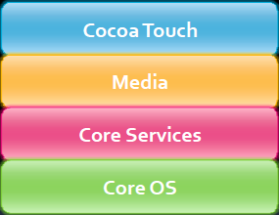
The iPhone OS
The iPhoneOS is a modified version of the Mac OS

Slide 12

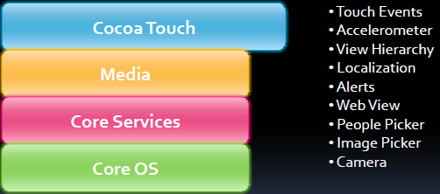
Cocoa Touch

Slide 13
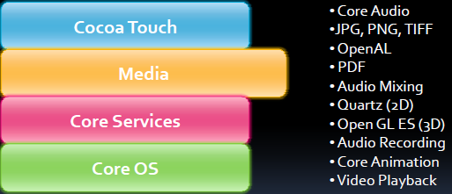
Media

Slide 14
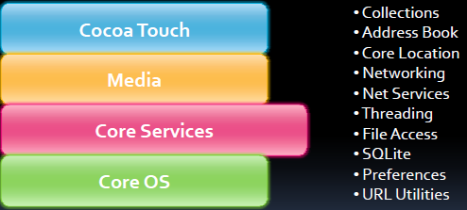
Core Services

Slide 15
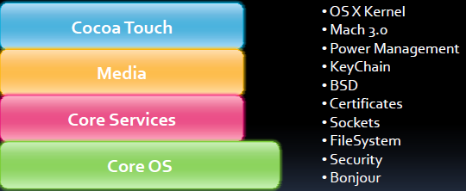
Core OS

Slide 16
Multitasking Myth
There is no truemulti-tasking on the iPhone OS
  Apples currently uses it only for their apps in a limited way
  There is no multi-tasking for third-party apps
  Keep that in mind when designing apps
    The home button is used to close application A
    Then the user clicks on the application B
    Finally goes back to application A
    All applications should save state to enhance user experience
However, there is multi-tasking on the iPhone OS
  Based off of Unix
  Can receive email while on a call
  Music can be playing in the background
  Apple disallowed third-party multi-tasking apps for performance reasons
http://www.roughlydrafted.com/2008/03/13/iphone-20-sdk-the-no-multitasking-myth/

Slide 17
Exercise
How to download an application from App store ?
What is unlocking, jailbreaking an iphone ?

Slide 18
Xcode
Xcode is a complete IDE to develop iPhone applications
  Running an Apple application in the simulator or on-target:
    iPhone
    iPod Touch
    iPad
Interface Builder
  Develop user interfaces
Performance Tools
  Memory, CPU, Disk…
http://developer.apple.com/technologies/tools/

Slide 19
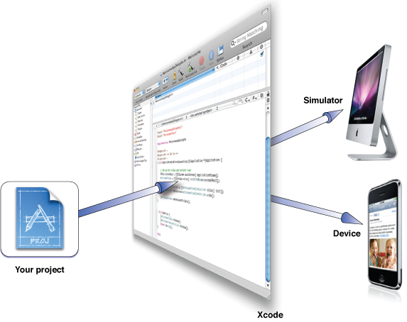
Xcode demo

Slide 20
Header file example
#import <Foundation/Foundation.h>
@interface Person
{
// instance variables
NSString *name;
int age;
}
// method declarations
- (NSString *)name;
- (void)setName:(NSString *)value;
- (int)age;
- (void)setAge:(int)age;
- (BOOL)canLegallyVote;
-(void)castBallot
-@end

Slide 21
Implementation File Example
#import "Person.h”
@implementation Person
@end
- (int)age {
return age;
}
- (void)setAge:(int)value {
age = value;
}
//... and other methods

Slide 22
Foundation Framework Classes
NSObject
NSString
NSMutableString
Collection : Array, Dictionary, Set
Enumeration
NSNumber

Slide 23
NSObject
Similar to ‘System.Object’ in .NET and ‘Object’ in Java
The base class for all other classes ie. Root
Implements basic functionality common across all classes:
  Introspection
  Object equality (‘==‘ by default checks only the address no deep compare)
  Memory management (alloc as we will see later)

Slide 24
NSObject
Examples of classes that derive directly from NSObject:
UIKit classes
  UIWindow
  UIButton
  UIAcceleration
  UIImage
  •UIResponder
http://developer.apple.com/mac/library/documentation/Cocoa/Reference/Foun
dation/Classes/NSObject_Class/Reference/Reference.html
http://developer.apple.com/iphone/library/documentation/UIKit/Reference/UIKit_Framework/Art/uikit_classes.jpg

Slide 25
NSString
Similar to String class in both Java and .NET
Supports Unicode so most languages of the world are support
Recommended to use this instead of C-Style char *
Very common use throughout the frameworks including Cocoa Touch

Slide 26
String Constants
In C/C++/C#/Java constant strings are written like this: “constant”
In ObjC constant strings are written like this: @”constant” (@ sign is important)!
Note that constant strings are instances of NSString (similar in concept with C++/Java…):
  NSString *string = @”Constant String”;

Slide 27
Common NSString Operations
- + (id) stringWithContentsOfFile: (NSString*)path;
- (BOOL) hasPrefix: (NSString *)string;
- (BOOL) isEqualToString: (NSString *) string //instead of shallow compare
- (int) intValue //parses the string – note exception handling coming soon…
- (NSString *)stringByAppendingString:(NSString *)string;
  NSString *aString = @”Good”;
  NSString *mainString;
  mainString = [aString stringByAppendingString:@” Morning!”];
  Now: mainString == @”Good Morning”\
  http://gnustep.org/resources/documentation/Developer/Base/Reference/NSString.html

Slide 28
Formatting Strings and NSLog
Similar to C/C++ printf but for NSString you have %@ argument/format specifier
For integers, and so forth use %d, and so forth
NSString *aString = @”Objective C”;
NSString *consoleOutput = [NSString stringWithFormat: @”%@ is great!”, aString];
Output: Objective C is great!
NSLog is similar to NSString but:
  Outputs to the command line
  Provides timestamp information
NSLog(@”My array size: %d; Is of type of: %@”, [array count], [array className]);
Output: My array size: 10; Is type of NSArray

Slide 29
NSMutableString
NSMutableString is a subclass of NSString
It allows a string to be modified instead of creating new copies in memory
Common NSMutableString operations
+ (id)string;
- (void)appendString:(NSString *)string;
- (void)appendFormat:(NSString *)format, ...;
NSMutableString *aString = [NSMutableString string];
[aString appendString:@”Hello”];
[newString appendFormat:@” , %@!”,[self myName]];

Slide 30
Collection Types
Here is an inexhaustive list of collection types:
  Array: an ordered collection of objects
  Dictionary: a collection of key-value pairs (eg. telephone numbers…)
  Set: an unordered collection of objects which are unique
Note iterating/enumerating through these collections is common

Slide 31
NSArray
Common NSArray methods
+ arrayWithObjects:(id)firstObj, ...; // Important: nil termination necessary
- (unsigned)count;
- (id)objectAtIndex:(unsigned)index;
- (unsigned)indexOfObject:(id)object;
NSNotFound returned for index if not found
NSArray *array = [NSArray arrayWithObjects:@”A”, @”B”, @”C”, nil];
if ([array indexOfObject:@”D”] == NSNotFound) {
NSLog (@”D element not found.”);
}

Slide 32
NSMutableArray
NSMutableArray is a subclass of NSArray and thus contains every operation Of NSArray
NSMutable Specific Methods:
+ (NSMutableArray *)array;
- (void)addObject:(id)object;
- (void)removeObject:(id)object;
- (void)removeAllObjects;
- (void)insertObject:(id)object atIndex:(unsigned)index;
Example of adding and removing elements
NSMutableArray *anArray = [NSMutableArray array];???
[array addObject:@”Element 1”];
[array addObject:@” Element 2”];
[array addObject:@” Element 3”];
[array removeObjectAtIndex:2];

Slide 33
NSDictionary
Common NSDictionary methods
+ dictionaryWithObjectsAndKeys: (id)firstObject, ...;
- (unsigned)count;
- (id)objectForKey:(id)key;
nil returned if no object found for given key
First arg is the object and the second is the key to the first object
And so forth… see example
NSDictionary *directory= [NSDictionary dictionaryWithObjectsAndKeys:
@”John Smith”, @”613-123-1234”,
@”Jane Smith ”, @”416-568-1234”,
@nil];
NSString *aShape = [shapes objectForKey:@”Triangle”];
if ([colors objectForKey:@”Circle”]) {
// do something here
}

Slide 34
NSMutableDictionary
NSMutableDictionary subclasses NSDictionary
Common NSMutableDictionary methods
+ (NSMutableDictionary *)dictionary;
- (void)setObject:(id)object forKey:(id)key;
- (void)removeObjectForKey:(id)key;
- (void)removeAllObjects;
NSMutableDictionary *mutableShapes = [NSMutableDictionary dictionary];
[mutableShapes setObject:@”Jane Smith” forKey:@”416-123-1234”];

Slide 35
NSSet
Unordered collection of objects
Common NSSet methods
+ setWithObjects:(id)firstObj, ...; // nil terminated
- (unsigned)count;
- (BOOL)containsObject:(id)object;

Slide 36
NSMutableSet
NSMutableSet subclasses NSSet
Common NSMutableSet methods
+ (NSMutableSet *)set;
- (void)addObject:(id)object;
- (void)removeObject:(id)object;
- (void)removeAllObjects;
- (void)intersectSet:(NSSet *)otherSet;
- (void)minusSet:(NSSet *)otherSet;

Slide 37
Enumeration
Consistent way of enumerating over objects in collections
Use with NSArray, NSDictionary, NSSet, etc.
NSArray *array = ... ; // assume an array of People objects
Person *person;
int count = [array count];
for (i = 0; i < count; i++) {
person = [array objectAtIndex:i];
NSLog([person description]);
}
‘for each’ like iteration in Objective C:
for (Person *person in array) {
NSLog([person description]);
}

Slide 38
NSNumber
Like Integer object in Java
NSNumber wraps regular C number types into objects
If you want to add objects to arrays, that’s how you do it
There is no mutable equivalent
Common NSNumber methods
+ (NSNumber *)numberWithInt:(int)value;
+ (NSNumber *)numberWithDouble:(double)value;
- (int)intValue;
- (double)doubleValue;

Slide 39
Exercise
Write a program that displays the following text:
  In Objective-C, lowercase letters are significant. main is where program execution begins. Open and closed braces enclose program statements in a routine. All program statements must be terminated by a semicolon. What is unlocking, jailbreaking an iphone ?
Write a program that subtracts the value 15 from 87 and displays the result, together with an appropriate message.

Slide 40
Exercise
Identify the syntactic errors in the following program. Then type in and run the corrected program to make sure you have identified all the mistakes:
  #import <Foundation/Foundation.h>
  int main (int argc, const char *argv[]);
  ( NSAutoreleasePool * pool = [[NSAutoreleasePool alloc] init];
  INT sum;
  /* COMPUTE RESULT //
  sum = 25 + 37 - 19
  / DISPLAY RESULTS /
  NSLog (@'The answer is %i' sum);
  [pool drain];
  return 0; }

Slide 41
Exercise
What output would you expect from the following program?
  #import <Foundation/Foundation.h>
  int main (int argc, const char *argv[]))
  {
  NSAutoreleasePool * pool = [[NSAutoreleasePool alloc] init];
  int answer, result; answer = 100;
  result = answer - 10;
  NSLog (@"The result is %i\n", result + 5);
  [pool drain]; return 0;
  }

Slide 42
Memory Management
Story
Alloc//Release
AutoRelease

Slide 43
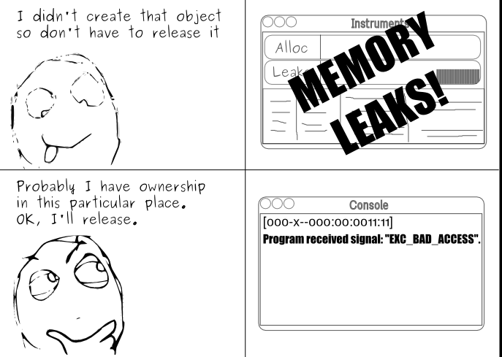
Memory Management

Slide 44
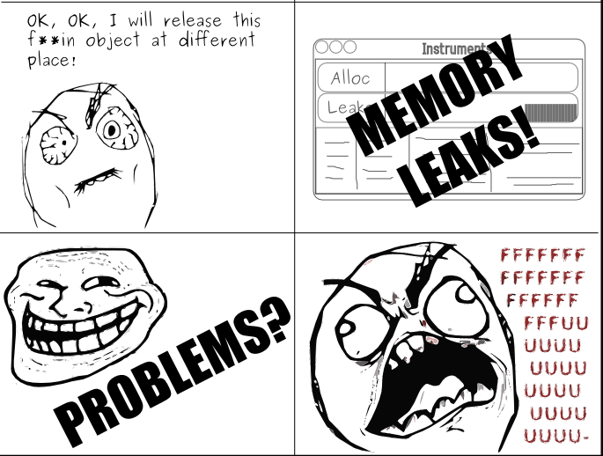
Memory Management

Slide 45
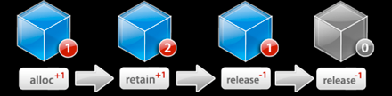
Memory Management
In Objective C on iPhoneOS, you have to manage your memory

Slide 46
Object Creation
In Objective C there is an explicit two-step object creation process:
+ alloc
  Allocate the block of memory needed for this object
  The class method which knows how much memory to allocate
- init
  Initialize the object’s state
  The instance method to set the initial values and perform other startup
  duties

Slide 47
Example
Shape *aShape = nil; //initializes memory to be 0’s and thus valid
aShape = [[Shape alloc] init];
[aShape setType:@”Triangle”];
[aShape calculatePerimeter];
// Since we are done with aShape we will call release.
// Its retain count will go to zero and thus dealloc will get called.
[aShape release];

Slide 48
Retain/Release Example
aShape = [[Shape alloc] init]; //retain count will equal one
[aShape retain]; //increment retain count by one
[aShape release]; //decrement retain count
[aShape release]; //retain count now zero, dealloc called.

Slide 49
A word about nil/NULL…
  The objects become like ‘NULL’ /nil– any attempt to access them will result in a crash:
  Shape *aShape = [[alloc Shape] init];
  // Object deallocated
  [aShape release];
  //Will result in a crash
  [aShape getPerimeter];
But if you had assigned nil to aShape right after release then no crash! Good convention

Slide 50
Autorelease
In some cases it doesn’t make sense to call release explicitely
  In below case, if you call release too early then garbage object sent
  If too late then that code will never get executed
  If no release at all (assuming not being called in dealloc) then memory leak!
- (NSString *)fullName {
NSString *result;
result = [[NSString alloc]
initWithFormat:@“%@ %@”,
firstName, lastName];
return result;
}

Slide 51
Autorelease
Method Names & Autorelease
Methods whose names includes alloc, copy, or new return a retained object that the caller needs to release
All other methods return autoreleased objects
This is a convention- follow it in methods you define!
NSMutableString *string = [[NSMutableString alloc] init];
// We are responsible for calling -release or –autorelease
[string autorelease];
NSMutableString *string = [NSMutableString string];
// The method name doesn’t indicate that we need to release

Slide 52
Autorelease cont’d
Calling -autorelease flags an object to be sent release at some point in the future
Let’s you fulfill your retain/release obligations while allowing an object some additional time to live
Makes it much more convenient to manage memory
Very useful in methods which return a newly created object

Slide 53
Autorelease cont’d
Object is added to current autorelease pool
Autorelease pools track objects scheduled to be released
When the pool itself is released, it sends -release to all its objects
If you want to keep the autorelease object for longer, call retain on it

Slide 54
Exercise
Write a program that create an object, retain it, then release it twice and display the retain count of that object in each step

Slide 55
References
http://developer.apple.com/
http://akosma.com/2009/01/28/10-iphone-memory-management-tips/

Slide 56
Question and answer
Thank you

